Slide 1
Dependency Injection by Constructor - Injecting primitive value
We can inject the dependency by constructor.
The <constructor-arg> sub-element of <bean> is used for constructor injection.
We can inject
primitive and String-based values
Dependent object (contained object)
Collection values etc.

Slide 2
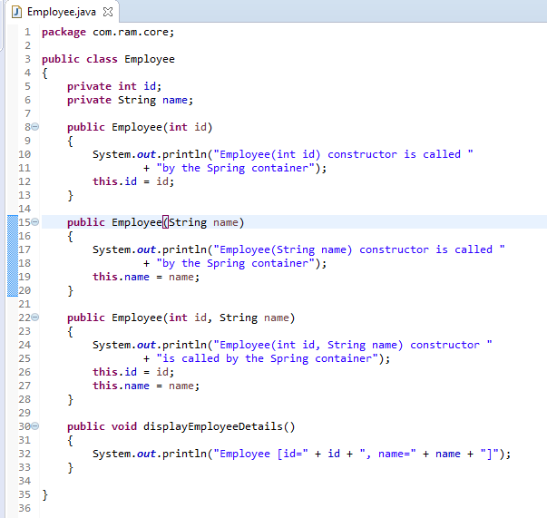
Dependency Injection by Constructor - Injecting primitive value

Slide 3
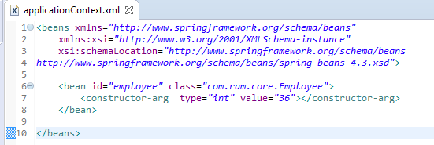
Dependency Injection by Constructor - Injecting primitive value
We are providing the information into the bean by applicationContext.xml file.
The constructor-arg element invokes the constructor. In such case, parameterized constructor of int type will be invoked. The value attribute of constructor-arg element will assign the specified value. The type attribute specifies that int parameter constructor will be invoked. In this example Employee(int id) constructor will be invoked.

Slide 4
Dependency Injection by Constructor - Injecting primitive value
Create employee object
Configure the employee object
Manage employee object complete life cycle from creation till destruction.
What object to instantiate?
What object to configure and how to configure?
Employee
The Spring Container
(ApplicationContext)
applicationContext.xml
Employee
Object
Id=36

Slide 5
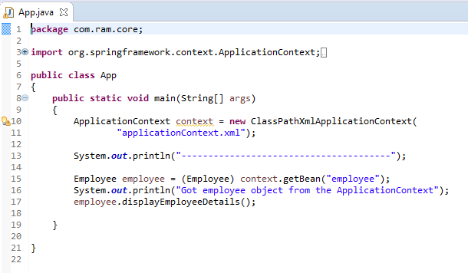
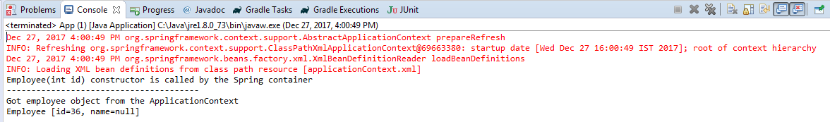
Dependency Injection by Constructor - Injecting primitive value

